Slide 1
ECE411 MP4 Final Presentation
Team: Always_f(@F)
Siddhant Singh(ss59)
Hemang Nehra(hnehra2)
Suraj Sharma (suraj2)

Slide 2
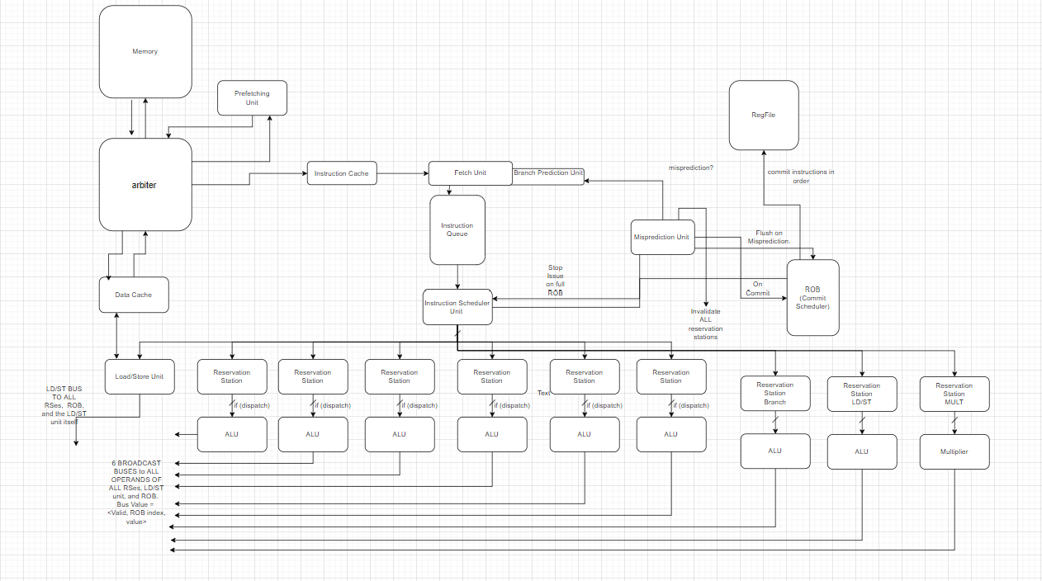
Overview of our design

Slide 4
Our Concept
We aimed to design and verify a microprocessor that utilizes architectural techniques found in modern processors. This inspired us to conceptualize a high ILP dynamically scheduled microprocessor

Slide 5
Our Concept
Out-of-Order Design based on the Tomasulo algorithm
Superscalar Design with 2-way issue and multiple commits in 1 cycle
RV32M extension
8kB 8-Way SA Pipelined I-Cache and D-Cache Memory Subsystem
One block lookahead prefetcher
Tournament Branch Predictor (Gshare + 2 bit up/down counter)

Slide 6
Features Implemented
Out-of-Order Design based on the Tomasulo algorithm
2kB 4-Way SA I-Cache and D-Cache Memory Subsystem
Sequential hardware prefetcher with stream-buffers
Dynamic Local Branch Predictor
Register Renaming with Reorder Buffer

Slide 7
Feature - Tomasulo
A parameterized circular queue serves as a backbone for our ROB, Instruction Queue, Load/Store Queue and st-br hazard detection mechanism
The ROB has a size of 32
The Load/Store Queue has a size of 32
The Instruction Queue has a size of 32
Flushing mechanism on mis-predicted jumps and branches

Slide 8
Feature - Cache
2kB 4-Way 16-Set-Associative Cache used as an I-Cache & D-Cache
The cache uses a pseudo-LRU policy

Slide 9
Feature - Prefetcher
Sequential hardware prefetcher for instructions
Utilizes Stream-Buffers to serve I-Cache misses in the arbiter. Stream-buffers can store 512 instructions
Reduces I-Cache miss penalty from ~20 cycles to 1 cycle if instruction sequence predicted correctly
Prefetching improved the total execution time by 30% on average during the execution of checkpoint codes

Slide 10
Feature – Branch Predictor
Implemented a Private History Branch Predictor
Utilizes a 2 bit up/down counter
BTB has a size of 128
Branch History Table has a size of 1024
Branch Prediction Rate for 89.39% for cp3 testcode.

Slide 11
Quantitative Results
Performance Analysis was performed on mp4-cp1, cp2 and cp3 testcodes
Comparative figures were taken from team LMP and RISC – Takers who implemented a pipelined design
LMP – Additional Features included during testing
  Parameterized and Pipelined Cache, BTB, Local BR predictor, eviction write buffer
RISC – Takers – Additional Features included during testing
  Prefetching, Pipelined 8-Way Cache and Multiplier

Slide 12
Quantitative Results
Fmax – 98.81MHz
Design | mp4-cp1 (ns) | mp4-cp2 (ns) | mp4-cp3 (ns)
Always_f(@F) | 6,795 | 5,050 | 1,859,050
RISC – Takers | 5,185 | 8,025 | 4,219,335
LMP | 7,895 | 5,075 | 789,045

Slide 13
Quantitative Results

Slide 14
Quantitative Results

Slide 15
Quantitative Analysis
From the figures illustrated in the previous slides, we can see that our design shows 50% improvement in execution time for cp3 code and 60% for cp2 code while taking 30% longer for cp1 testcode compared to the design of team RISC - Takers
When our design is compared to team LMP, we can see that our design twice as long for cp3 code and 16% faster for cp1 testcode. The execution time for cp2 codes were near identical for both the designs.
We believe the massive performance difference comes from their implementation of pipelined cache coupled with our aggressive instruction prefetching which increases D-cache miss penalty

Slide 16
Performance Bottlenecks
D-Cache miss penalty can be very high (~20-40) cycles due to aggressive instruction prefetching
Only 1 Reservation Unit for resolving br, jal and jalr so which causes scheduler to stall instruction issues
Only 1 Reservation Unit for resolving ld, st memory addresses so which causes scheduler to stall instruction issues

Slide 17
Proposed Solutions to reduce Bottlenecks
L2 D-Cache and pipelined D-Cache Hierarchy will help reduce the D-cache miss penalty which is proving to be the bottleneck of the design
Implementing Data Prefetching along with a less-aggressive instruction prefetching mechanism
Increasing the number of reservation units for resolving ld, st memory address calculations
Pipelining various control units such as; scheduler; commit logic to increase Fmax

Slide 18
Features in Progress
Superscalar 2-Way Issue and multiple commits
8kB 8-Way SA Cache
Gshare Branch Predictor with Tournament
RV32M extension

Slide 19
If we had to start over…
We would implement a software model to ease the verification process
More Robust Verification on edge cases such as processor flushing and memory interactions

Slide 20
Special Thanks
Professor Nam Sung Kim
Eric Dong
Team – RISC – Takers
Team - LMP

Slide 21
Questions?

